Slide 1
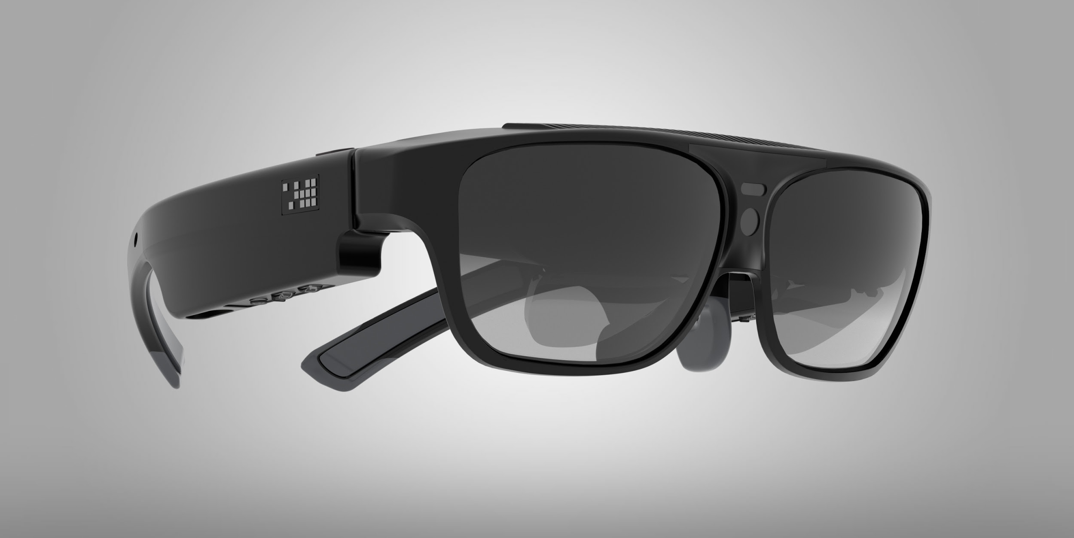
Aero-Glass
Emre Unal

Slide 2
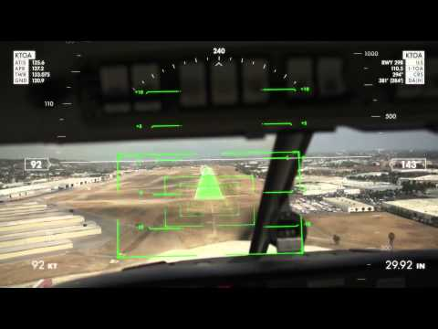
Aero-Glass

Slide 3
What is Aero-Glass?
Provides an augmented reality navigation experience using smart glasses in an 3D, 360° experience.
Provides an unique solution addressing pilots’ needs without the requirement of using other devices, phone or tablet.

Slide 4
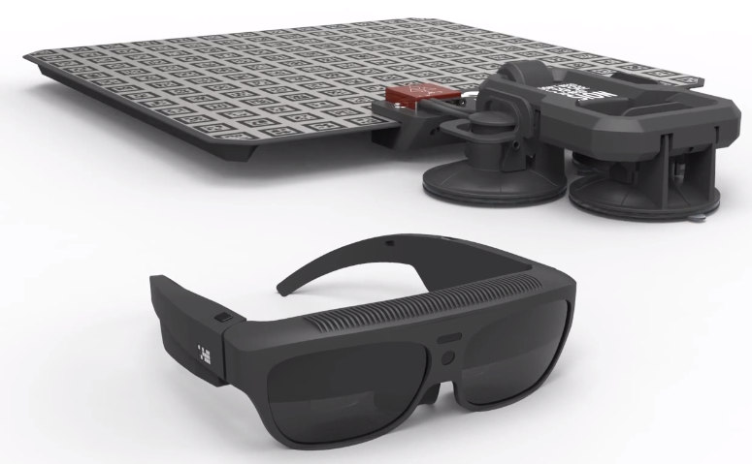
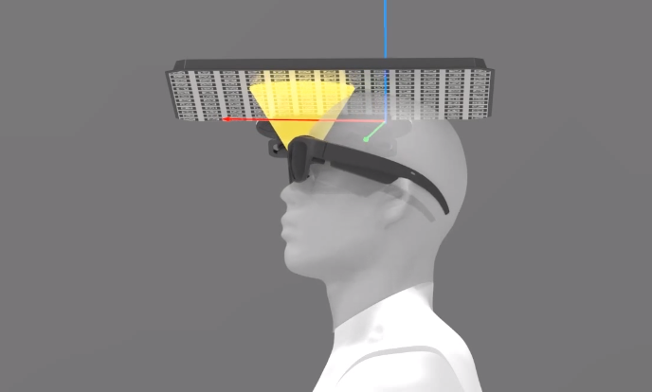
How Does It Work?
Custom Head Tracking System
Small infrared camera sends information to marker board.
Attitude and Position of Aircraft
Information comes from F.A.A which return into 3D Database and load into smart glass. GNSS-INS receiver device gathers live traffic data from Automatic Dependent Surveillance - Broadcast (ADS-B).
Combined Information runs on smart-glasses which process all the data and generates 3d-mixed reality symbology right in front of your eyes. Thus, it provides 360° augmented reality.

Slide 5
Why Aero-Glass is unique
Pilots will see features that are otherwise invisible such as airways, procedures, navigation points, airports, taxiways, terrain, other aircrafts and weather.
Provides high heading precision for a safe augmented reality.

Slide 6
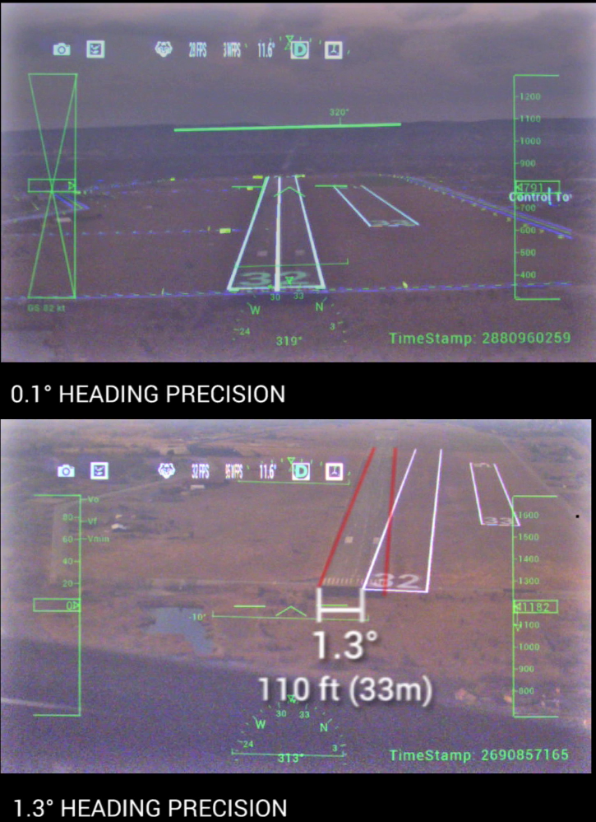
Flight with a 0.1° and another with 0.3° precision
Heading imprecision over 0.5° results in a misleading and hazardous augmented reality overlay.

Slide 7
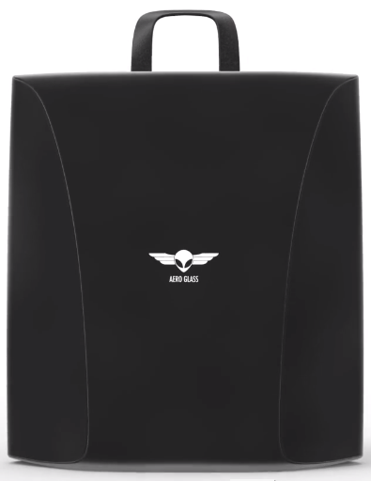
Strengths / Weaknesses
Accurate information
Portable
Doesn’t lead any dizziness (Rating 0)
Pricing (Full equipment costs $25000)

Slide 8
Related Applications
No similar augmented reality applications.
Virtual reality applications to make pilot trainings more cost-effective:
BISimulator: https://bisimulations.com/
https://avr.flights/
Virtual reality applications for aviation maintenance training
EonReality: https://www.eonreality.com/

Slide 9
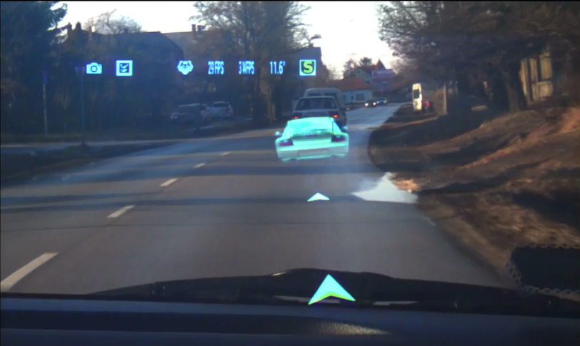
Potential Applications
Navigation for cars: Car drivers would simply follow a virtual car on the real road for navigation guidance to find their desired destination instead of looking at their GPS display inside car.

Slide 10
Conclusion
Aero-glass is an unique solution for pilots’ needs during flight and provides all-around 360° display capacity and experience in the cockpit regardless of visibility.
Aero-glass will help the pilots of future to avoid costly mistakes and make timely decisions that will save lives.

Slide 11
Questions?

